Slide 1
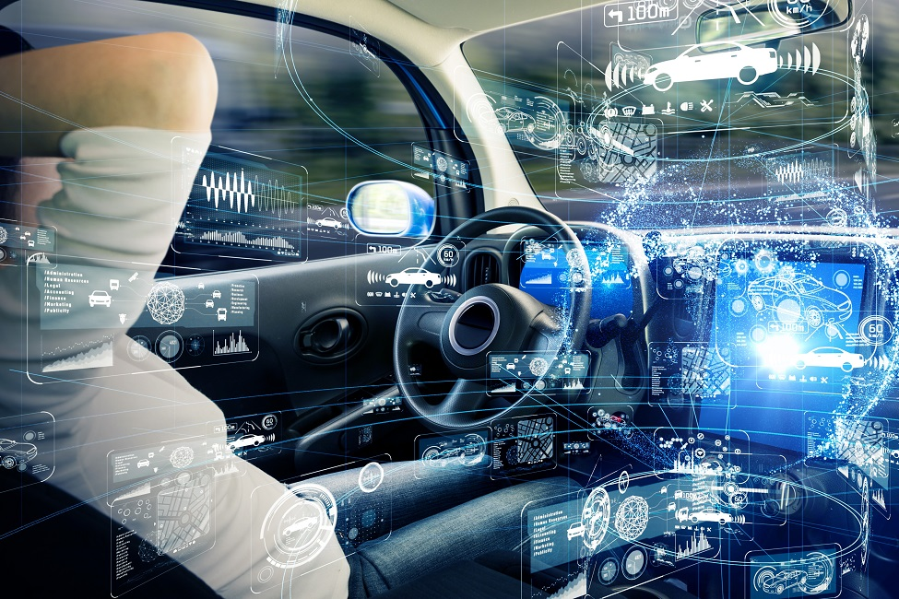

Traffic Sign Recognition
Mirna Dabagh
Charles Brook
Shamim Munshi

Slide 2






Agenda
Business Understanding
Data Understanding
Data Preparation
Modelling
Evaluation
Deployment
Conclusion
This Photo by Unknown Author is licensed under CC BY-SA

Slide 3




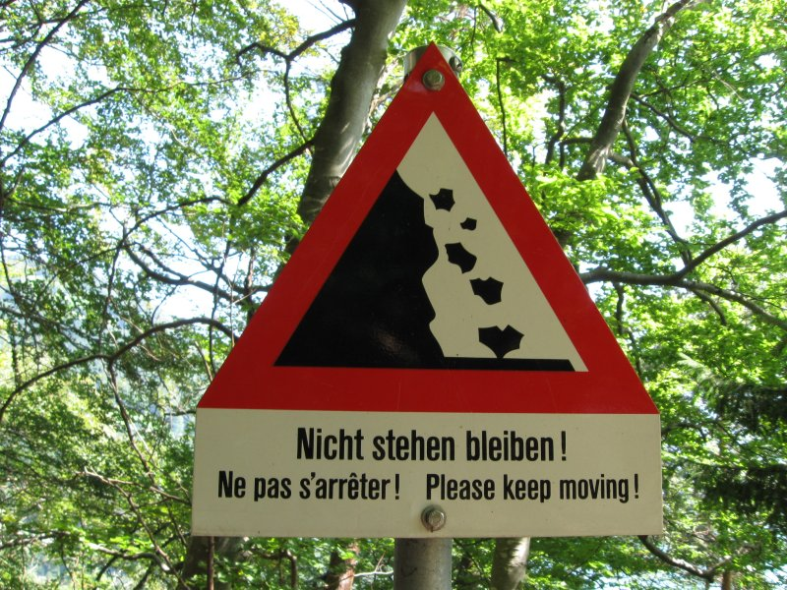
Introduction
New age of Artificial Intelligence, humans increasingly dependent on Tech
Many companies working on automated vehicles e.g. Google, Tesla, Uber
Aim to create autonomous/driverless vehicles that interpret road signs accurately
Many algorithms have been created to ensure 100% road safety & accuracy
Traffic Sign Recognition algorithm recognises which class a traffic sign belongs to
Project: Build a model to classify German traffic signs using CNN & Keras library

Slide 4

Business Understanding
What does the business need?

Slide 5

Determine business objectives: Understand what customer / client is trying to achieve, including business success criteria. Assess situation: Determine resources availability, project requirements, assess risks and contingencies, & conduct cost-benefit analysis. Determine project goals: In addition to defining business objectives, should also define what success looks like from technical data mining perspective. Produce project plan: Select technologies & tools & define detailed plans for each project phase.
Notes:
1. What are we trying to do? Sort images of traffic signs into classes such that we can identify what type of sign each image represents and therefore understand its meaning whether mandatory or advisory (for example: speed limits; no entry; mandatory turn instruction; traffic signals; children crossing; uneven surface; etc.)
2. Situation: In this case, we will work with an example dataset with a large number (>50K) of images. These images are taken of traffic signs situated in Germany (and so follow German standards). Images are of varying size and quality, and taken from different lateral angles and elevations.
3. What does success look like? Given the potential negative outcomes of failure to correctly identify traffic signs in “real world” scenarios, we should be attempting to correctly identify 100% of all signs encountered. We should also ensure that the classification system “fails safe”, so in any situation where a traffic sign cannot be definitively identified, we unambiguously point out this failure.
4. Project plan: Briefly mention potential tools and technologies? Not sure we need a full project plan/schedule for such a minor piece of work.

Slide 6
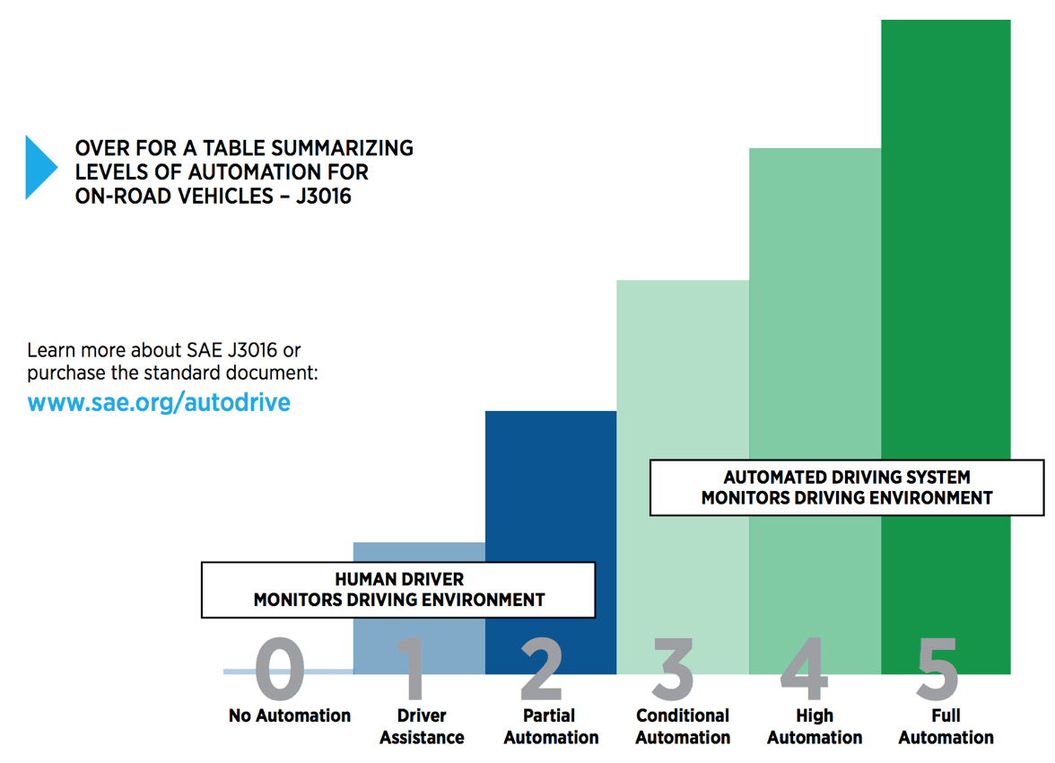
Switch to Increasingly Automated Vehicles
Driverless car manufacturers such as Waymo, Ford, Tesla, Volkswagon, Audi and Uber are creating self-driving cars with an automated driving system that monitors the driving environment.

Slide 7
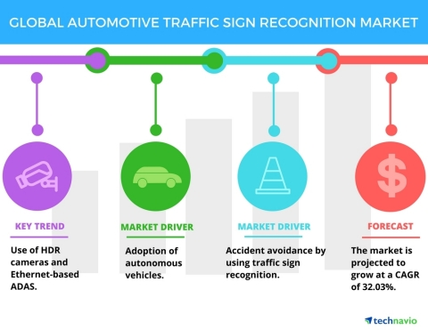
Demand for Automotive Traffic Sign Recognition The global automotive traffic sign recognition market was expected to grow at an impressive Compound Annual Growth Rate (CAGR) of around 32% during the period 2017-2021, according to a market research study by Technavio.* *Source: Key Insights on the Automotive Traffic Sign Recognition Market | Technavio | Business Wire

Slide 8

Neural Networks are a set of algorithms that are designed to recognize patterns. Before using these algorithms, real-world data (images, sound, text, etc.) must be translated into numerical values. Initially, human input is needed to train the algorithm to find correlations between the input and the output. Once trained, these algorithms can be used to classify unlabelled data according to similarities among the items in the dataset.
Neural Networks & Image Classification

Slide 9
Steps for Implementation
Dataset
Import libraries. Load & extract dataset.
Visualisation
Data visualisation: visualisation of the data to understand the key features of the dataset.
Preparation
Data preparation for training the model and to evaluate it’s performance.
Augmentation
Architecture
Model Architecture: design a high-performance model.
Data Augmentation: increase the amount and diversity in the data.
Training
Evaluation
Model evaluation: validate it’s accuracy and draw conclusions.
Model Training.

Slide 10
Data Understanding
What data do we have/ need?
Is the data clean?

Slide 11

Collect initial data: Acquire the necessary data and (if necessary) load it into your analysis tool. Describe data: Examine the data and document its surface properties like data format, number of records, or field identities. Explore data: Dig deeper into the data. Query it, visualize it, and identify relationships among the data. Verify data quality: How clean/dirty is the data? Document any quality issues.
Notes:
The dataset was made available via Kaggle.
Utilising the standard Windows file explorer utility, it has been established that the dataset consists of two directories: a “train” directory of 39,209 images, and a “test” directory of 12,629 images. The “train” directory” provided has already been divided up into 43 directories, each representing a single class of traffic sign. Each image is in PNG (Portable Network Graphic) format. The size of the image (number of horizontal and vertical pixels in an image) is unknown, but while initially the exact method for classifying images has not been determined, it is expected that any training algorithm will need consistent image inputs. Therefore images with the highest and lowest pixel-counts will likely need to be determined.

Slide 12

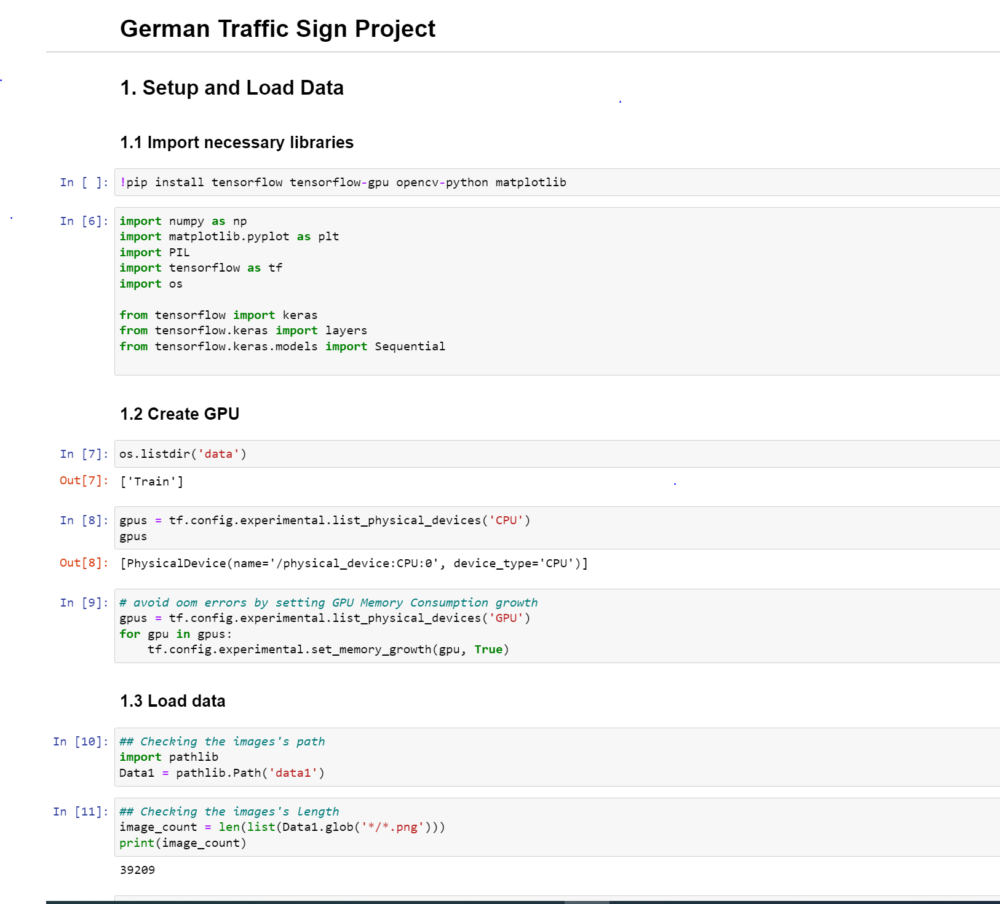
Import Libraries
NumPy– NumPy arrays are very fast and can perform large computations in a very short time.
MatPlotLib– This library is used to draw visualisations.
PIL - Python Imaging Library uses lightweight image processing tools for editing, creating & saving images.
Tensorflow –Provides range of functions to achieve complex functionalities with single lines of code.

Slide 13

Load & Extract Dataset
The dataset has 42 classes of Traffic Signs and a label.csv file.
The folder is in zip format that is then extracted.
All the images are then loaded in a single list in the form of an array
To feed the image data to the CNN model, the data is first converted into a NumPy array.

Slide 14
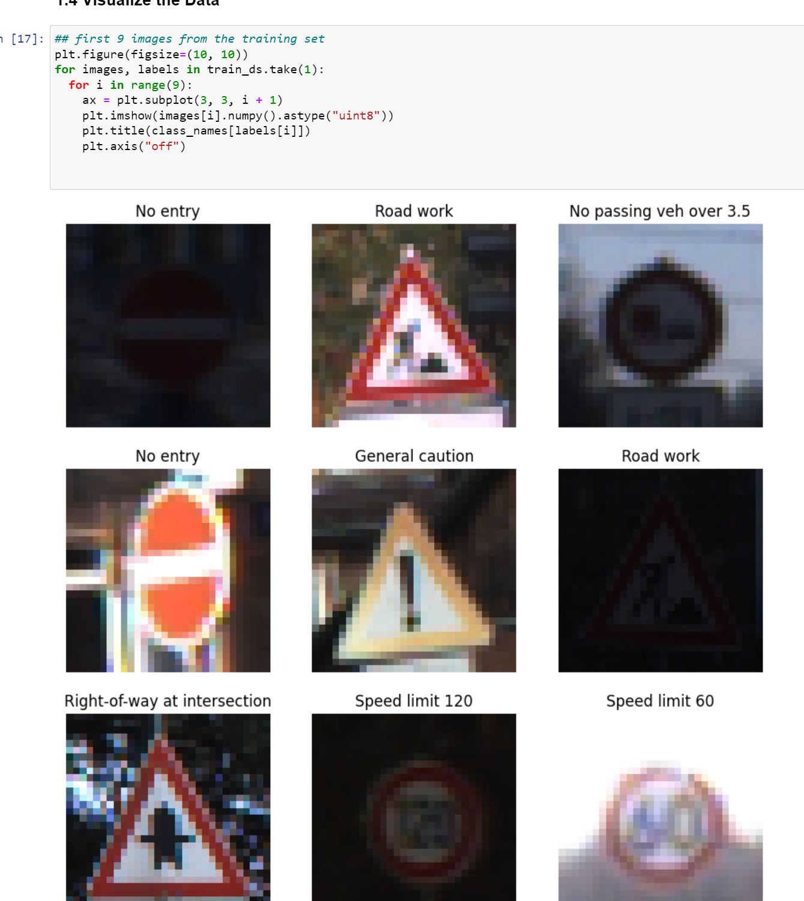
Data Visualisation
Data visualisation means the visualisation of data to understand the key features of the dataset.
Once the dataset has been loaded, random images from the different folders can be visualised.

Slide 15
Data Preparation
How do we organise the data for modelling?

Slide 16

Select data: Determine which data sets will be used and document reasons for inclusion/exclusion. Clean data: Often this is the lengthiest task. Without it, you’ll likely fall victim to garbage-in, garbage-out. A common practice during this task is to correct, impute, or remove erroneous values. Construct data: Derive new attributes that will be helpful. For example, derive someone’s body mass index from height and weight fields. Integrate data: Create new data sets by combining data from multiple sources. Format data: Re-format data as necessary. For example, you might convert string values that store numbers to numeric values so that you can perform mathematical operations.

Slide 17
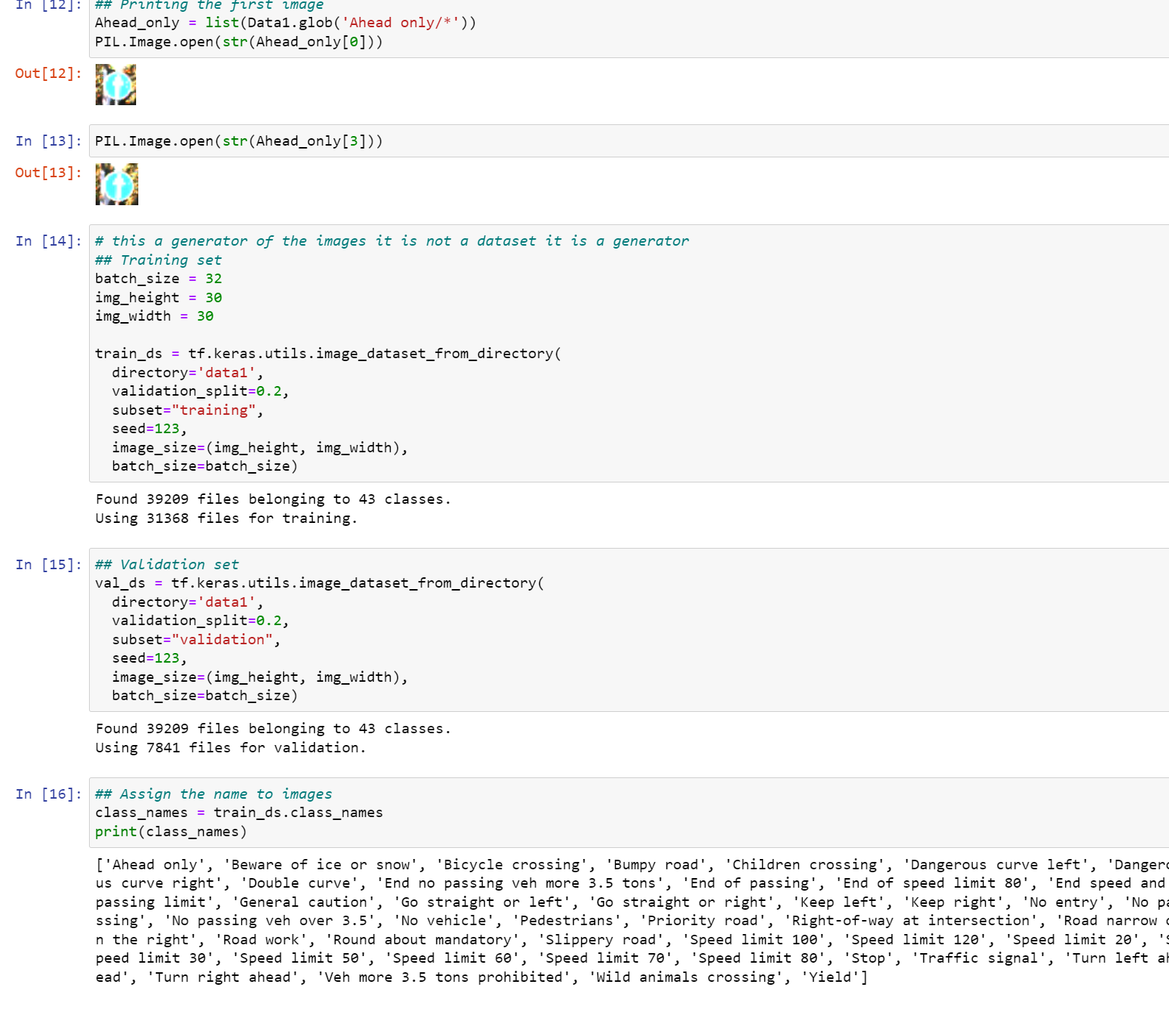
Data Preparation for Training
At this stage, the dataset is split into a train & a validation set.
Train set will be used to train the model.
Validation set will be used to evaluate the performance of our model.

Slide 18
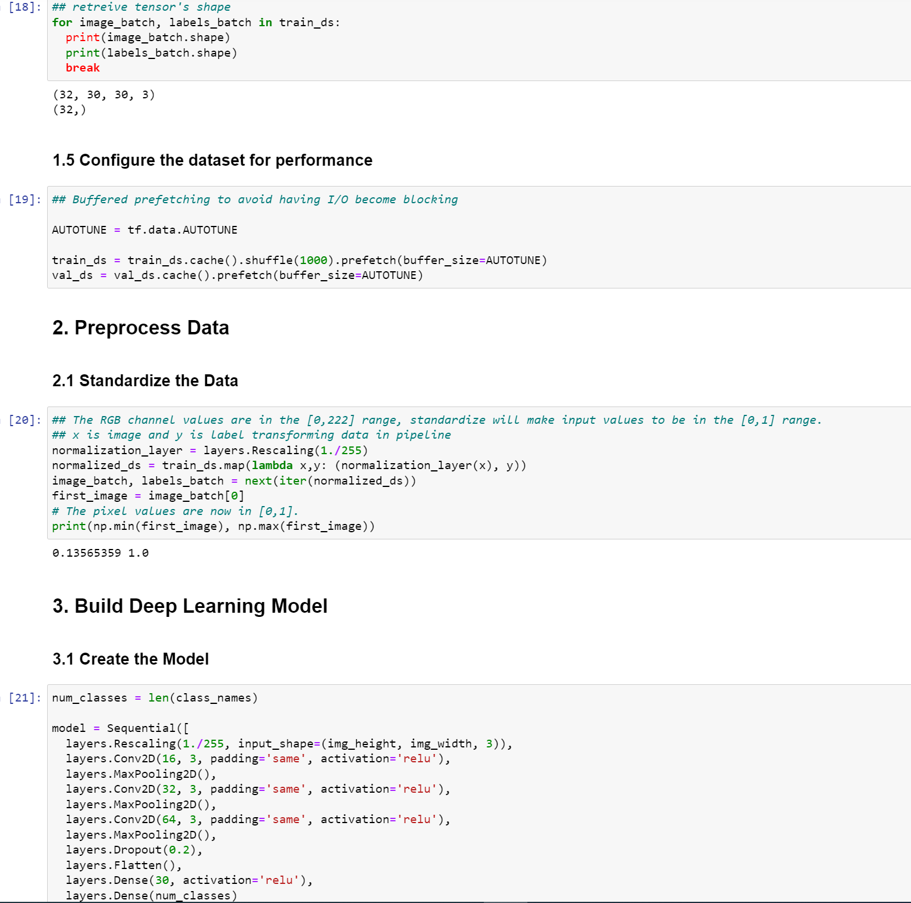
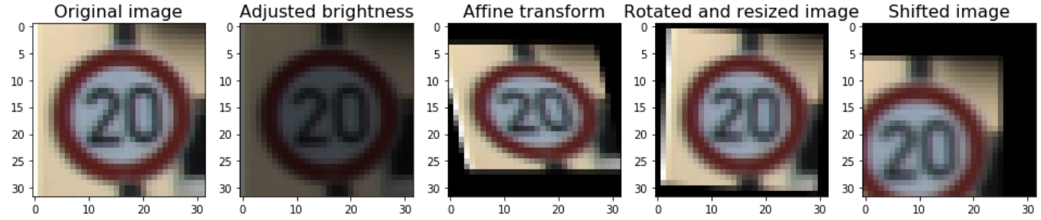
Data Augmentation
Occasionally the data is limited & the model is not performing well with limited data.
In these cases, we use Data Augmentation.
It is the method to increase the amount and diversity in the data to increase the accuracy of the model.
New data is not collected, rather the already present data is transformed.

Slide 19
Modelling
What modelling techniques should we apply?

Slide 20
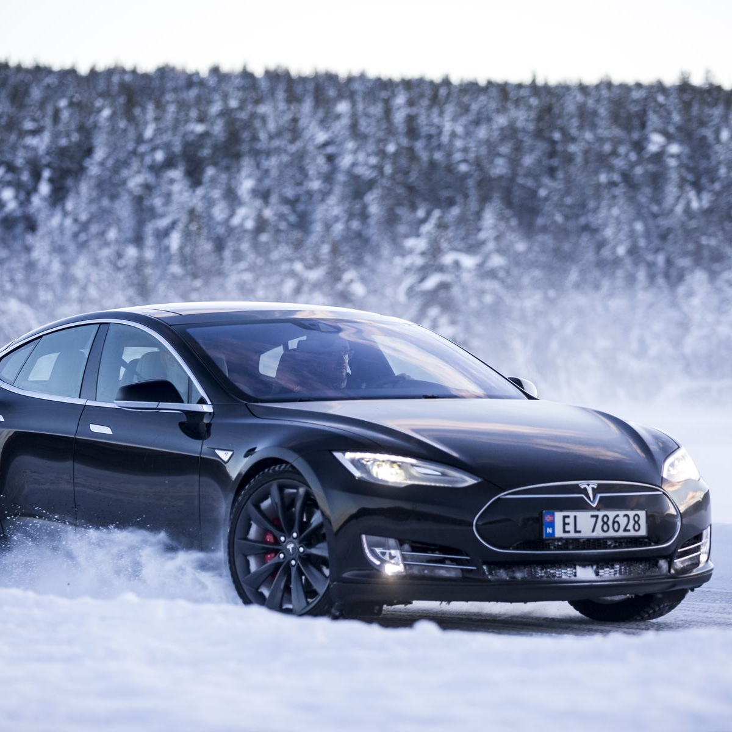
Select modelling techniques: Determine which algorithms to try (e.g. regression, neural net). Generate test design: Pending your modelling approach, you might need to split the data into training, test, and validation sets. Build model: As glamorous as this might sound, this might just be executing a few lines of code like “reg = LinearRegression().fit(X, y)”. Assess model: Generally, multiple models are competing against each other, and the data scientist needs to interpret the model results based on domain knowledge, the pre-defined success criteria, and the test design.

Slide 21
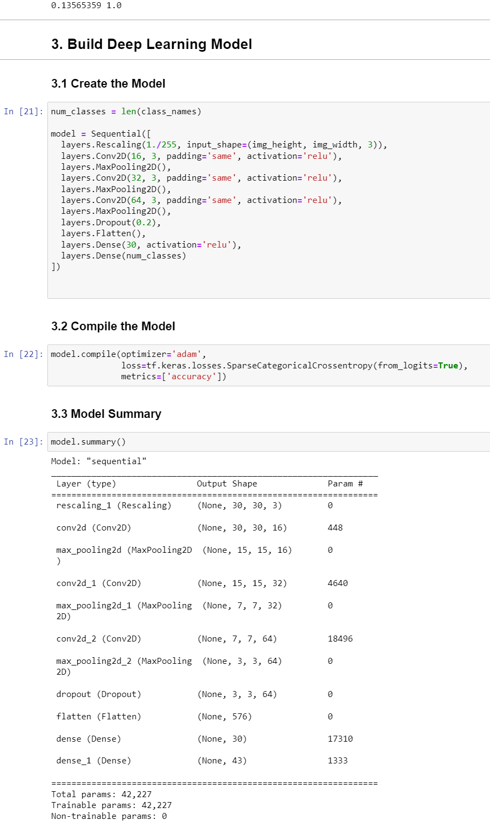
Model Architecture
A CNN model is built to classify images for correct labels as it is the best choice to work with image data.
The architecture of the CNN model:
MaxPool- This layer is used to reduce the size of images.
Dense – for the feed-forward neural network.
Flatten – It converts the parrel layers to squeeze the layers.
Dropout – It is a regularization technique to reduce overfitting.

Slide 22
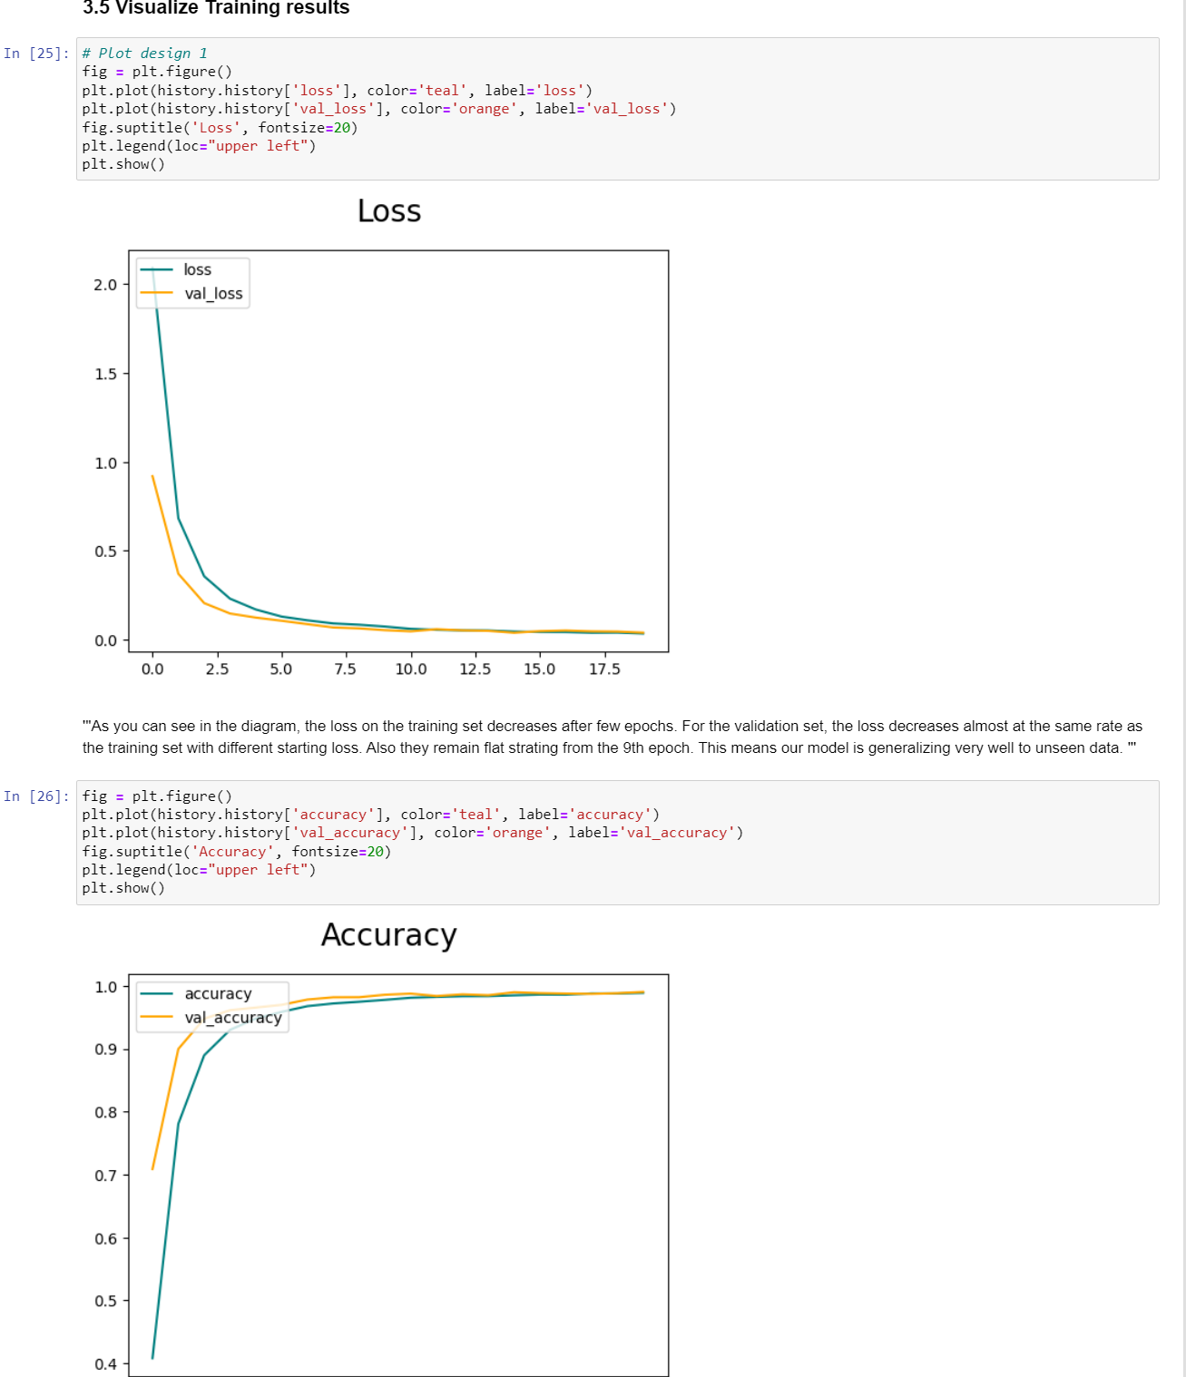

Model Training
The model performance is very good.
The graphs show increasing accuracy and decreasing loss.

Slide 23
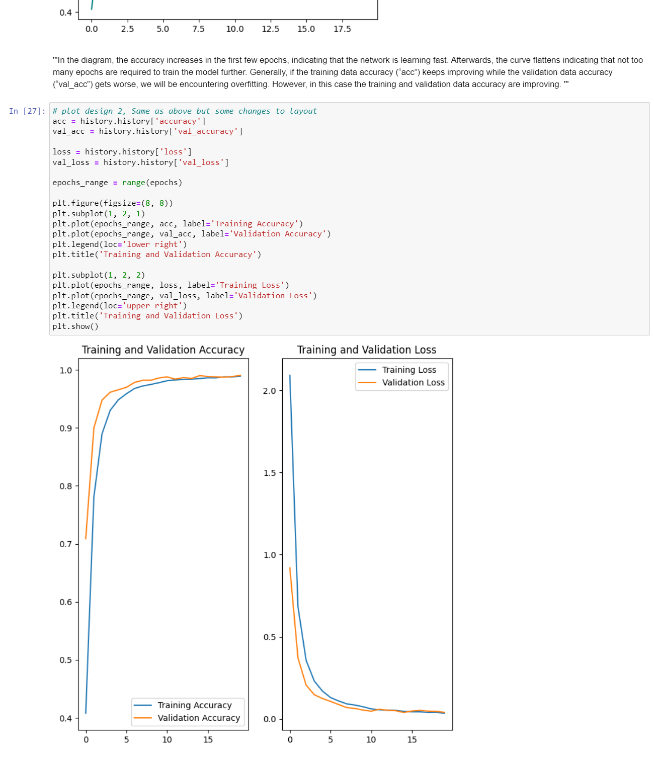
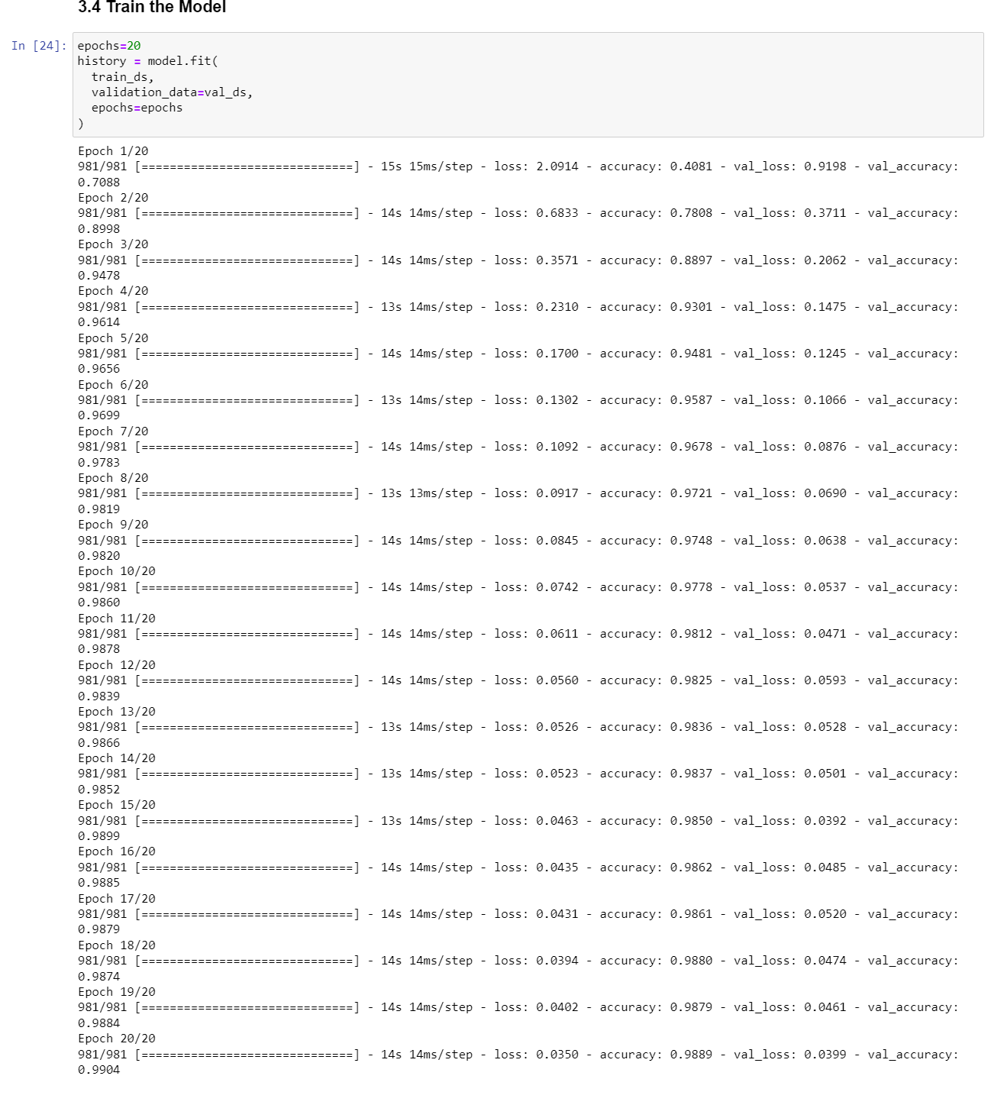
Model Training
The train and test data is fitted to the model and the convolutional model is trained. Several epochs are defined to train for and batch size while introducing the model.

Slide 24
Evaluation
What best meets the business objectives?

Slide 25
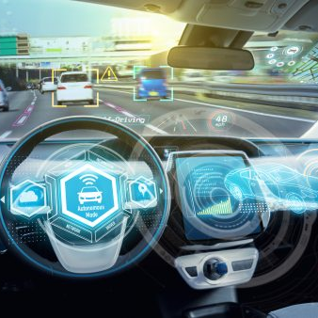
Evaluate results: Do the models meet the business success criteria? Which one(s) should we approve for the business? Review process: Review the work accomplished. Was anything overlooked? Were all steps properly executed? Summarize findings and correct anything if needed. Determine next steps: Based on the previous three tasks, determine whether to proceed to deployment, iterate further, or initiate new projects.

Slide 26
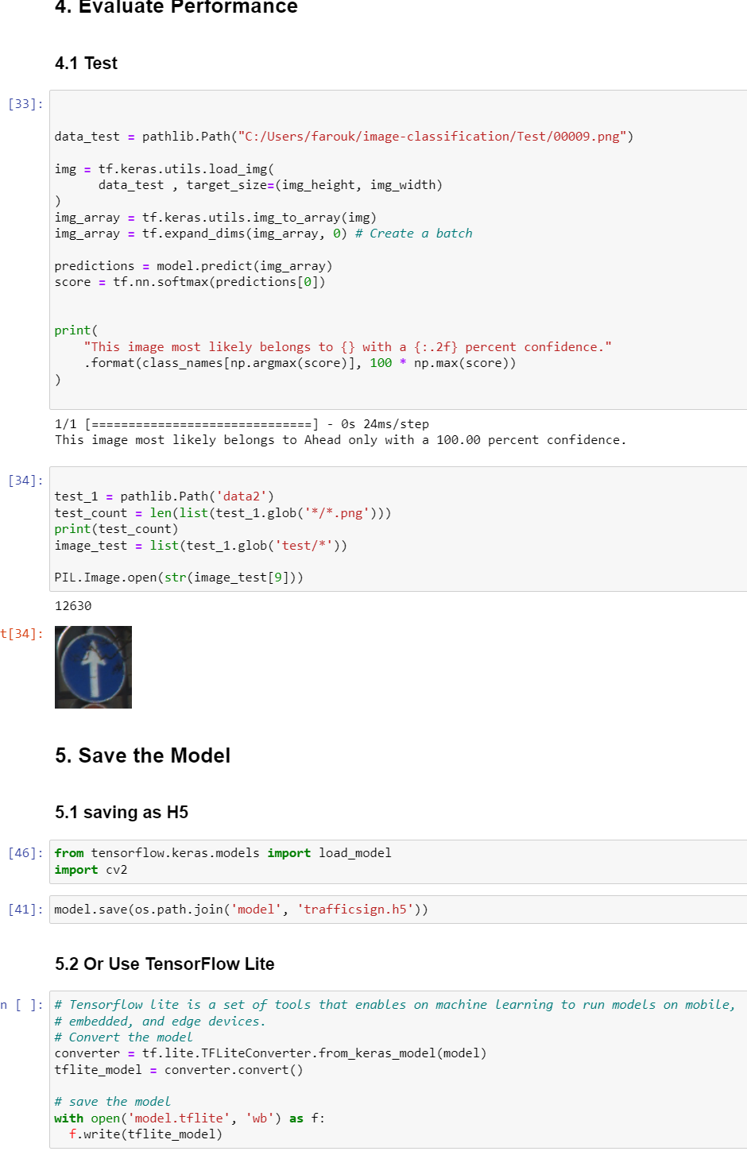
Model Evaluation
The dataset contains a test folder with different test images and a test.csv file.
The CSV file contains the details about the image path & their respective labels.
The data is loaded again using pandas & each image resized into the shape of 30*30 pixels.
The input image is converted to a NumPy array.
After processing test data images, the model's accuracy is checked against actual labels.

Slide 27
Deployment
How do stakeholders access the results?

Slide 28

Plan deployment: Develop and document a plan for deploying the model. Plan monitoring and maintenance: Develop a thorough monitoring and maintenance plan to avoid issues during the operational phase (or post-project phase) of a model. Produce final report: The project team documents a summary of the project which might include a final presentation of data mining results. Review project: Conduct a project retrospective about what went well, what could have been better, and how to improve in the future.

Slide 29
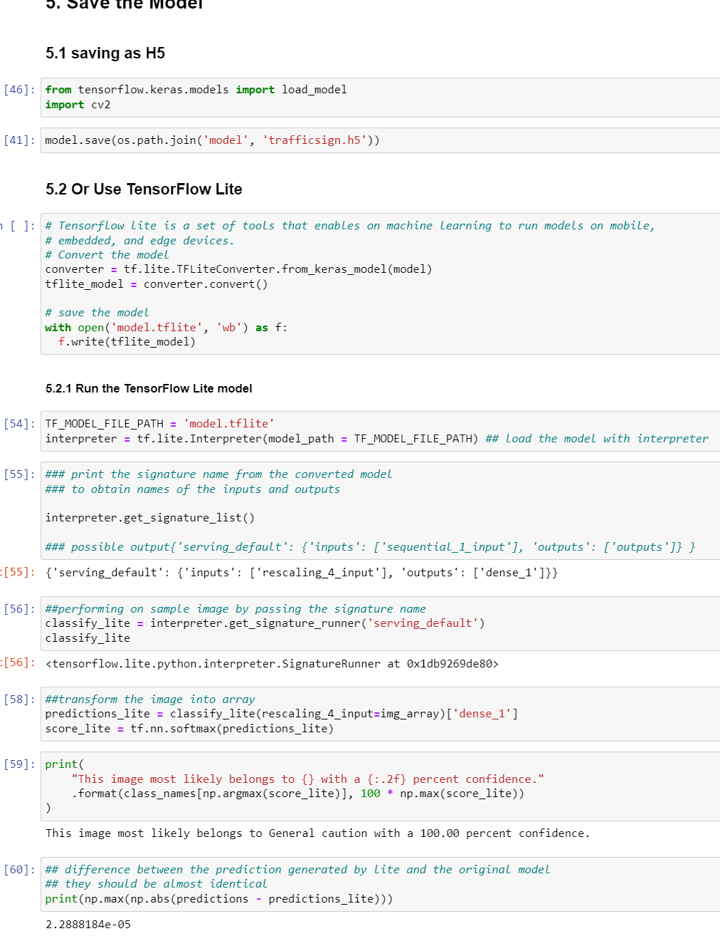
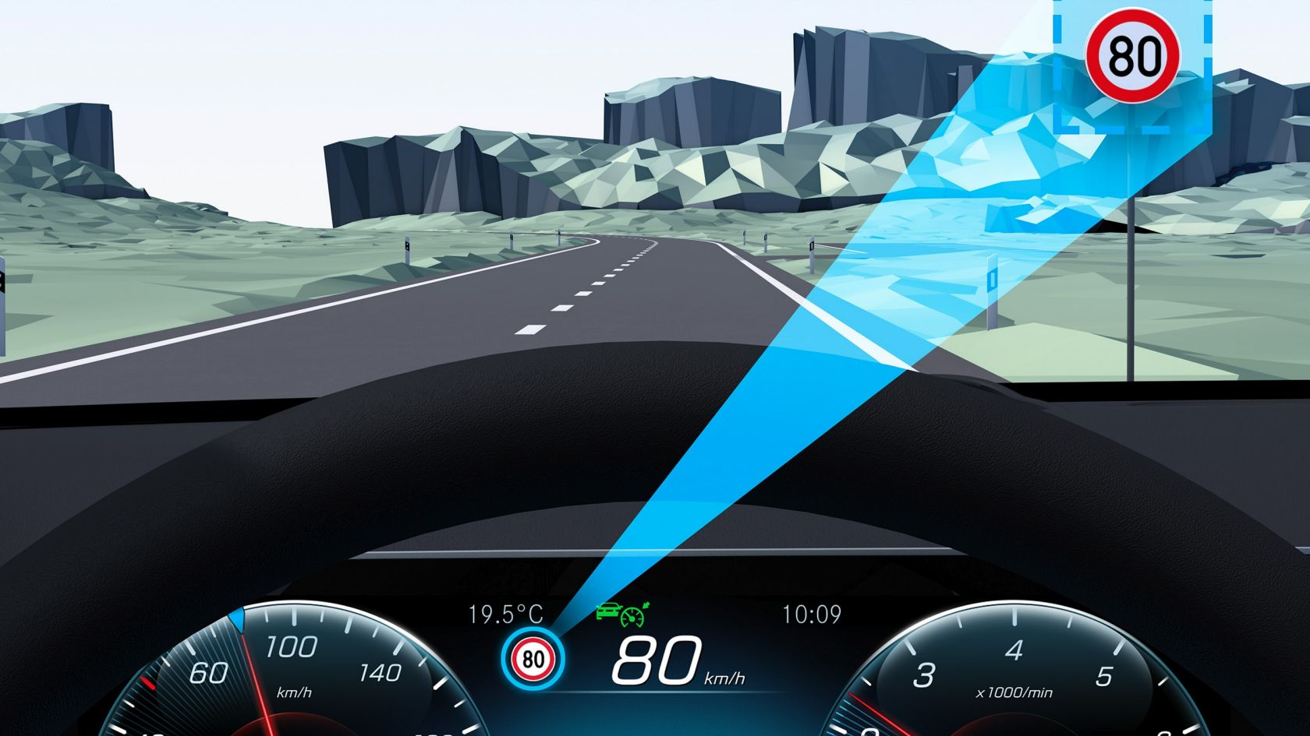
Conclusion
What have we discovered? The purpose of using the CNN model for image processing models.
So what? The usefulness of traffic recognition systems
Q&A

Slide 30


Thank You
Presenter name: Mirna Dabagh
Co-designers:
Charles Brook & Shamim Munshi
IoC Skills Bootcamp: Data Science & Cloud Systems at Birmingham City University
15th December 2022
Dataset Source:
:https://www.kaggle.com/datasets/meowmeowmeowmeowmeow/gtsrb-german-traffic-sign
Sources:
Traffic Signs Recognition using CNN and Keras in Python – GeeksforGeeks
Traffic Signs Recognition with 95% Accuracy using CNN & Keras – YouTube
Traffic Sign Recognition using CNN - Coding Ninjas CodeStudio

